Slide 1
PowerPoint template to accompany the Black History Month 2019 lesson pack for:
Key Stage 4 – England and Wales
S5 to S6 - Scotland
We know that good teaching is tailored to meet the needs of the children or young people in each individual class. That’s why we’ve created this editable PowerPoint template – feel free to adapt it to suit your teaching context or to add your school or college slide template to the background.
Who are Stonewall?
This resource is produced by Stonewall, a UK-based charity that stands for the freedom, equity and potential of all lesbian, gay, bi, trans, queer, questioning and ace (LGBTQ+) people. At Stonewall, we imagine a world where LGBTQ+ people everywhere can live our lives to the full. Founded in London in 1989, we now work in each nation of the UK and have established partnerships across the globe. Over the last three decades, we have created transformative change in the lives of LGBTQ+ people in the UK, helping win equal rights around marriage, having children and inclusive education.
Our campaigns drive positive change for our communities, and our sustained change and empowerment programmes ensure that LGBTQ+ people can thrive throughout our lives. We make sure that the world hears and learns from our communities, and our work is grounded in evidence and expertise.
Stonewall is proud to provide information, support and guidance on LGBTQ+ inclusion; working towards a world where we’re all free to be. This does not constitute legal advice, and is not intended to be a substitute for legal counsel on any subject matter. To find out more about our work, visit us at www.stonewall.org.uk.
Registered Charity No 1101255 (England and Wales) and SC039681 (Scotland)
Notes:
Visit our website for the lesson pack to accompany this PowerPoint.

Slide 2
LO: To understand what intersectionality is
Notes:
Create a list of ground rules as a class i.e respecting identities and opinions - this may also include no judgement, not speaking over each other and being honest with any and all questions we have.

Slide 3
LO: To understand what intersectionality is
What is Black History Month?
Notes:
Start with a class discussion on BHM and the form is has taken in the past.
What does BHM mean to the students? Why is BHM marked in calendars? Why is it significant? Highlight that historically racism and racist discrimination meant that black people were held back from accessing the same opportunities as white people – and also the many achievements and contributions to history of the black community were not talked about, highlighted or celebrated as much as they should have been (and sometimes not talked about at all). We’ve made progress today but black people are still underrepresented in lots of areas, including the media, politics and leadership, and racism and racist discrimination against black people still happens far too often – so it’s important that we go on having these conversations.
Lean discussion into intersectionality. Ask students how many of them have heard of the term before. Ask them what they think it means.

Slide 4
LO: To understand what intersectionality is
Intersectionality is a way of looking at a person’s identity. Someone’s identity is made up of lots of different bits – for example, age, race, gender, disability status etc. Sometimes, people will experience discrimination or unfair treatment from others on the basis of a bit of their identity. Some people will experience discrimination on the basis of several bits of their identity all at the same time. We call this an ‘intersect’.
Notes:
The term ‘intersectionality’ was coined by Kimberlé Crenshaw, an American civil rights activist and leading scholar of critical race theory. Intersectionality is a way of looking at a person’s identity or who they are. It recognises that someone’s identity is made up of lots of different bits and all those bits are important in different ways – for example, a person’s age, race, gender, disability status etc might all be important bits of who they are. The different bits of a person’s identity and how they are perceived by others might influence the way they’re treated by others and the opportunities they have access to in society. Sometimes, people will experience discrimination or unfair treatment from others on the basis of a bit of their identity – for example, a person experiencing racist discrimination or a person experiencing sexist discrimination. Some people will experience discrimination on the basis of several bits of their identity all at the same time: for example, a black woman might experience discrimination both on the basis of her race and on the basis of her gender. We call this an ‘intersect’: when two different bits of a person’s identity, or several different bits, overlap and the overlap affects the way they are treated or their experiences.
Look at the definition of intersectionality together. Discuss where the different aspects of identity come from. Are there any parts of people’s identities missing from this definition? Write a definition as a class.

Slide 5
LO: To understand what intersectionality is
Who have you learnt about in the past?
What might be the different intersects in the identities of the people you have learnt about in the past?
Who is missing from our lessons?
Notes:
In groups or pairs have the students discuss the questions on the slide.
Have tables feedback on their discussions to hold a class discussion.
Discuss each of the intersects students have drawn out. IF the class has not brought up LGBT identities of their own accord, direct them towards it.
Can the class think of any LGBT black role models? Think. Pair. Share.

Slide 6
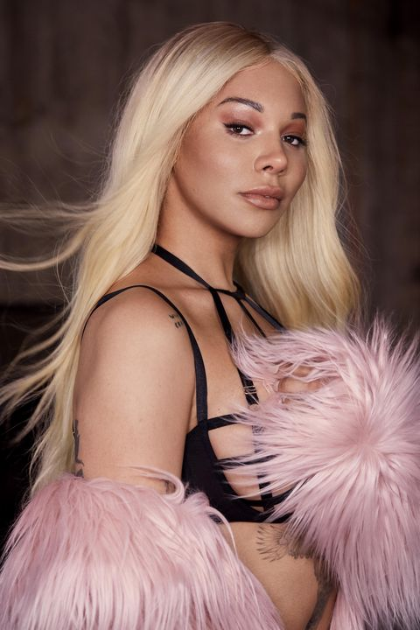
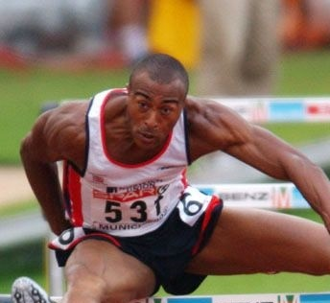
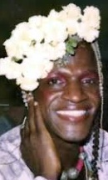
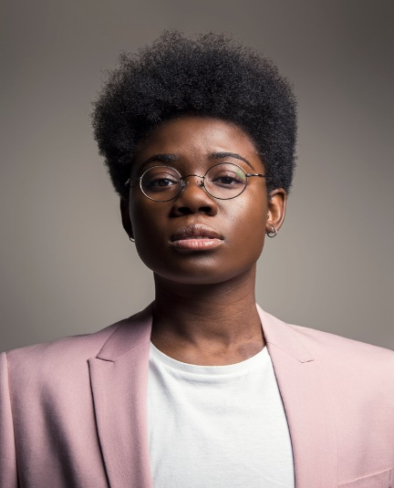
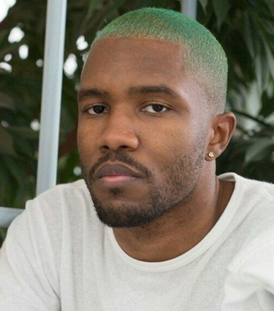
LO: To understand what intersectionality is
Notes:
Show students different role models on the board (Colin Jackson – former hurdler, Dr Ronx – Emergency medical doctor , Marsha P Johnson – trans activist credited with starting the Stonewall Riots which sparked the modern day LGBT rights movement, Munroe Bergdorf – Model and trans activist, Janelle Monae – Singer/Songwriter, Frank Ocean – Singer/Songwriter)
Ask: What have these people got in common? Think. Pair. Share.
Ask: What else might these people have in common? Think. Pair. Share.
Ask: Why do you think these people are role models? Think,. Pair. Share.

Slide 7
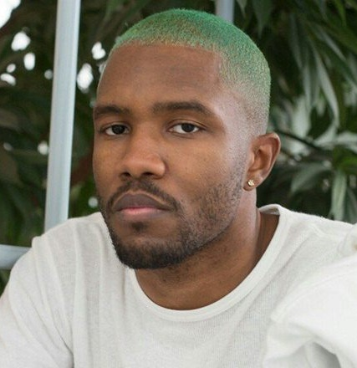
LO: To understand what intersectionality is
Janelle Monae is an American singer/songwriter. She came out as pansexual on the cover of rolling stone in 2018.
Munroe Bergdorf is a model and activist who has walked runways at NYC and London. She is also trans.
Frank Ocean is an American singer, songwriter, rapper, record producer, and photographer. Frank Ocean came out as bi on Tumblr.
Notes:
Share the additional information about each person and discuss that they are all LGBT.

Slide 8
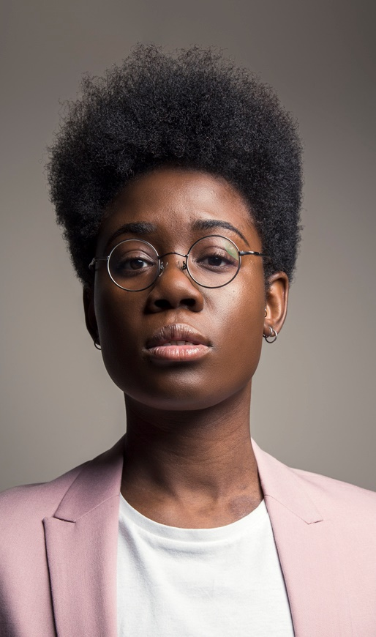
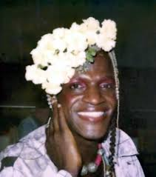
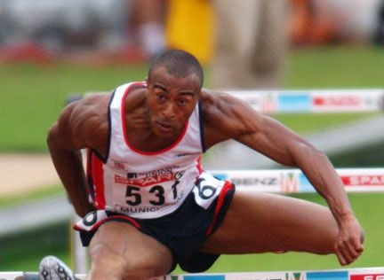
LO: To understand what intersectionality is
Dr Ronx is an Emergency medicine doctor by profession. They describe themself as a queer, black, androgynous intersectional feminist.
Marsh P Johnson was a prominent figure of the Stonewall Riots in 1969 and gay rights activist. She was also trans.
Colin Jackson held the 110m hurdles world record for more than a decade. He still holds the record for 60m hurdles. He came out as gay in 2017.
Notes:
Share the additional information about each person and discuss that they are all LGBT.

Slide 9
LO: To understand what intersectionality is
Notes:
Have each of the students choose one of the role models they have just been told about, or any others they can think of and create social media profiles for them. This might be an Instagram or Facebook profile. They must include a detailed bio that has information that they have learnt in today’s lesson.
To end the lesson dot the profiles around the classroom. Have students go around with post it notes and like/leave a comment on one another’s profiles

