Slide 1
PowerPoint template to accompany the LGBT+ History Month 2019 lesson pack for:
KS1 – England and Wales
P2 to P3 – Scotland
We know that good teaching is tailored to meet the needs of the children or young people in each individual class. That’s why we’ve created this editable PowerPoint template – feel free to adapt it to suit your teaching context or to add your school or college slide template to the background.
Who are Stonewall?
This resource is produced by Stonewall, a UK-based charity that stands for the freedom, equity and potential of all lesbian, gay, bi, trans, queer, questioning and ace (LGBTQ+) people. At Stonewall, we imagine a world where LGBTQ+ people everywhere can live our lives to the full. Founded in London in 1989, we now work in each nation of the UK and have established partnerships across the globe. Over the last three decades, we have created transformative change in the lives of LGBTQ+ people in the UK, helping win equal rights around marriage, having children and inclusive education.
Our campaigns drive positive change for our communities, and our sustained change and empowerment programmes ensure that LGBTQ+ people can thrive throughout our lives. We make sure that the world hears and learns from our communities, and our work is grounded in evidence and expertise.
Stonewall is proud to provide information, support and guidance on LGBTQ+ inclusion; working towards a world where we’re all free to be. This does not constitute legal advice, and is not intended to be a substitute for legal counsel on any subject matter. To find out more about our work, visit us at www.stonewall.org.uk.
Registered Charity No 1101255 (England and Wales) and SC039681 (Scotland)
Notes:
Visit our website for the lesson plan to accompany this PowerPoint.

Slide 2
LO: To be able to talk about my family and
To be able to respond to a poem

Slide 3
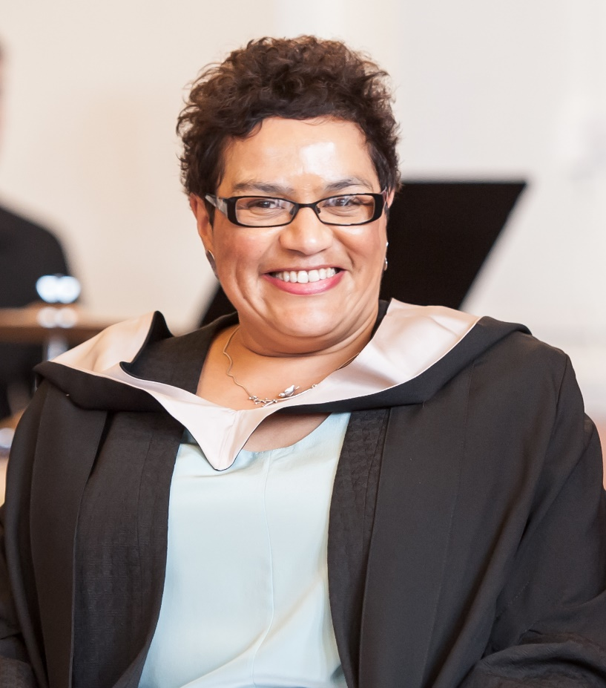
LO: To be able to talk about my family and to be able to
respond to a poem
Grandpa’s Soup – a poem by Jackie Kay
Notes:
Read Grandpa’s Soup by Jackie Kay to the children. You can find the poem here: https://www.scottishpoetrylibrary.org.uk/poem/grandpas-soup/
Ask children if they can remember what was in the soup.
When they remember an ingredient, invite a child to the front up to add it to the pan. Explain that hough is a type of beef.
Ask: Why did Jackie like Grandpa’s soup so much? Discuss that it might have been more than just that it was tasty, it might be that because it is something that Grandpa made for her.

Slide 4
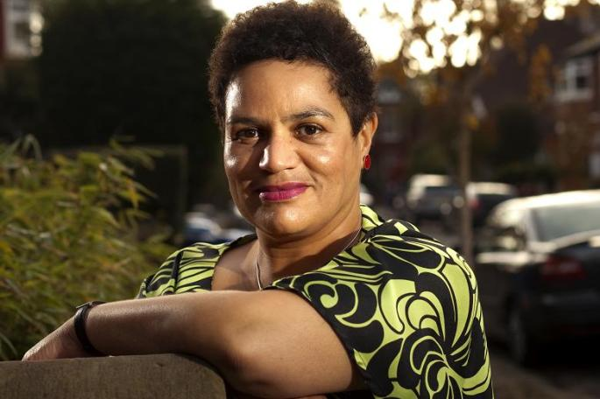
LO: To be able to talk about my family and to be able to
respond to a poem
This is Jackie Kay
She is a poet.
She grew up in Scotland.
She was adopted when she was a baby.
She lives with her partner, Denise.
She has two children.
Notes:
Show children a photo of Jackie Kay and talk about her family. Jackie was adopted when she was a baby and she grew up with her mum, dad and siblings. She now lives with her partner Denise. Jackie has two children, so Denise is their step-mum.

Slide 5
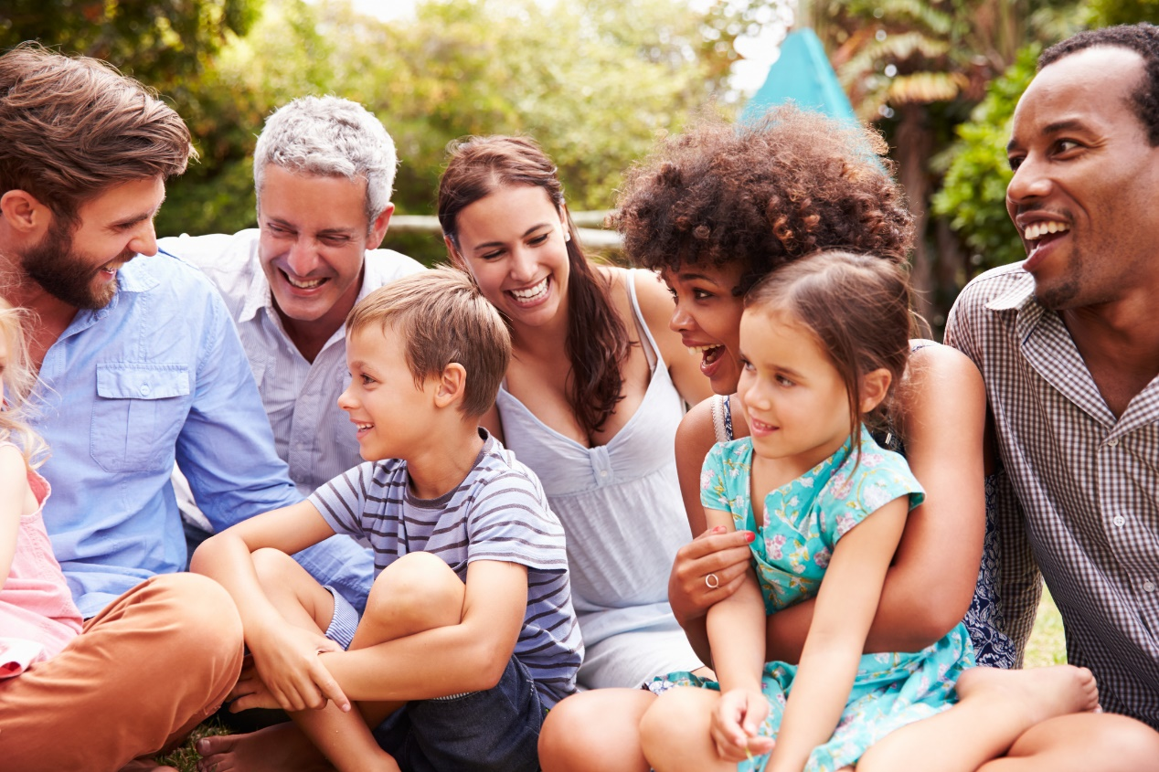
LO: To be able to talk about my family and to be able to
respond to a poem
Who is in your family? What foods are special to your family?
Notes:
Ask children: Who is in your family?
Children should tell a partner. Choose some children to tell the class who is in their family - make sure that a diverse range of families are discussed.
Ask children: Are any foods special to you and your family? Why are the foods special to you?
Talking partners and then share as a class.
Note: Be aware that children with a trans parent might use a different name for their parent instead of mum or dad.

Slide 6
LO: To be able to talk about my family and to be able to
respond to a poem
No one makes soup like our class,
with its diced ______ the perfect size
and its diced ______ the perfect size
and its wee soft bits -
what are their names?
and its big bit of ____,
which ryhmes with _____, floating
like a ______ in the middle of the soup sea.
I say, ____, ____ your soup is the best soup in the whole world.
And _____ says, _____,
which rhymes with _______ and ____,
Don't be daft,
because they know they’re shy about their soup, my class.
Notes:
As a class, re-write Grandpa’s Soup to create a class poem, with ingredients you agree upon as a class.

Slide 7
LO: To be able to talk about my family and to be able to
respond to a poem
Make a collage
Write a shopping list
Notes:
Children use the class soup recipe to help them make a collage of the soup, sticking the ‘ingredients’ onto the soup bowl template.
Children should write a shopping list – either bullet pointed or as an opportunity to practice using commas.
Children can write the name of someone from their family that they want to share the class soup with.

Slide 8
LO: To be able to talk about my family and to be able to
respond to a poem
Would your soup be tasty?
Who would you share it with?
Notes:
Children use the class soup recipe to help them make a collage of the soup, sticking the ‘ingredients’ onto the soup bowl template.
Children should write a shopping list – either bullet pointed or as an opportunity to practice using commas.
Children can write the name of someone from their family that they want to share the class soup with.

