Slide 1
PowerPoint template to accompany the LGBT+ History Month 2019 lesson pack for:
Year 5 and 6 – England and Wales
P6 and P7 – Scotland
We know that good teaching is tailored to meet the needs of the children or young people in each individual class. That’s why we’ve created this editable PowerPoint template – feel free to adapt it to suit your teaching context or to add your school or college slide template to the background.
Who are Stonewall?
This resource is produced by Stonewall, a UK-based charity that stands for the freedom, equity and potential of all lesbian, gay, bi, trans, queer, questioning and ace (LGBTQ+) people. At Stonewall, we imagine a world where LGBTQ+ people everywhere can live our lives to the full. Founded in London in 1989, we now work in each nation of the UK and have established partnerships across the globe. Over the last three decades, we have created transformative change in the lives of LGBTQ+ people in the UK, helping win equal rights around marriage, having children and inclusive education.
Our campaigns drive positive change for our communities, and our sustained change and empowerment programmes ensure that LGBTQ+ people can thrive throughout our lives. We make sure that the world hears and learns from our communities, and our work is grounded in evidence and expertise.
Stonewall is proud to provide information, support and guidance on LGBTQ+ inclusion; working towards a world where we’re all free to be. This does not constitute legal advice, and is not intended to be a substitute for legal counsel on any subject matter. To find out more about our work, visit us at www.stonewall.org.uk.
Registered Charity No 1101255 (England and Wales) and SC039681 (Scotland)
Notes:
Visit our website for the lesson plan to accompany this PowerPoint.

Slide 2
LO: To be able to use an extended metaphor

Slide 3
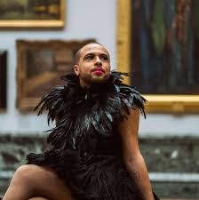
LO: To be able to use an extended metaphor
I want to be a pink flamingo – a poem by Dean Atta
Notes:
As a class, read or listen to part of I want to be a pink flamingo by Dean Atta. You can find the poem at 0:42 until 1:27 in the video here: https://www.youtube.com/watch?vs=0UdejBoQ1v8
Please note: The rest of the video is not included in this lesson plan. Some of the poems in the rest of the video are only suitable for older students.
Ask: Does the poet actually want to be a flamingo? Discuss/revisit the concept of a metaphor.

Slide 4
LO: To be able to use an extended metaphor
What is it called when we use a word or idea to represent something else?
Notes:
Ask: Does the poet actually want to be a flamingo? What is it called when we use a word or idea to represent something else? Discuss the idea of a metaphor.

Slide 5
LO: To be able to use an extended metaphor
A metaphor is a descriptive tool.
It is a word or phrase that describes something as if it were something else.
Notes:
Ask: Does the poet actually want to be a flamingo? What is it called when we use a word or idea to represent something else? Discuss the idea of a metaphor.

Slide 6
LO: To be able to use an extended metaphor
I want to be a pink flamingo.
A wave of terror passed over them.
She had the eyes of a hawk.
Notes:
Discuss/revisit the concept of a metaphor.
Challenge children to come up with some other metaphors. Think. Pair. Share.

Slide 7
LO: To be able to use an extended metaphor
If you extend a metaphor, you use words that relate to the original metaphor throughout your writing.
Notes:
Move the discussion on the idea of an extended metaphor.

Slide 8
LO: To be able to use an extended metaphor
An extended metaphor:
It was an epic battle between Manchester United and Chelsea. The players fought bravely throughout.
Notes:
Move the discussion on the idea of an extended metaphor.

Slide 9
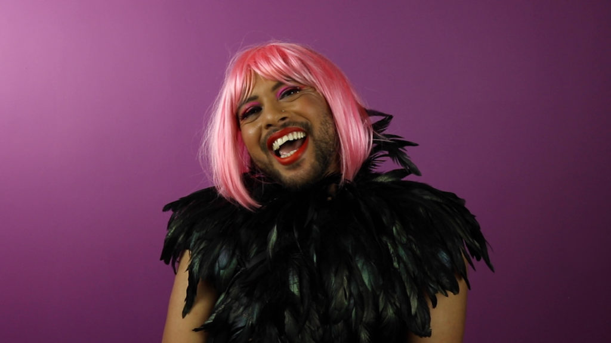
LO: To be able to use an extended metaphor
How can we let people know that it’s ok to be different?
Notes:
What can we do to help our friends know that it’s ok to be different? Discuss that it’s important to actively work to understand people’s differences and to show that we value them as an individual.

Slide 10
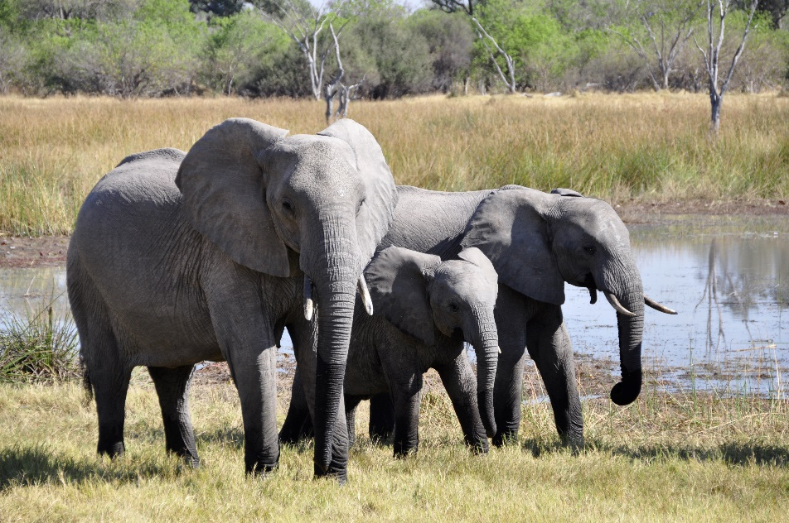
LO: To be able to use an extended metaphor
What animal would you like to be?
Why?
Notes:
In small groups, children should discuss:
What animal would you like to be and why? What characteristics of the animal would you like to have in your life? (for example being brave like a penguin or caring like an elephant)

Slide 11
LO: To be able to use an extended metaphor
Today we’re going to be writing a poem that uses an extended metaphor.
Notes:
Children write a poem in the style of The Pink Flamingo, based on the animal they have chosen. The poem should make it clear that it is about them and that it is a metaphor for something they aspire to.
Adaptation: Children who struggle with writing could work with the teacher or teaching assistant to shared write a poem about an animal. See also the activity for Year 3 and Year 4 (P4 and P5)

Slide 12
LO: To be able to use an extended metaphor
Write a poem based on the animal you have chosen.
The poem should be about you.
You should choose words that extend your metaphor through the poem.
Notes:
Children write a poem in the style of The Pink Flamingo, based on the animal they have chosen. The poem should make it clear that it is about them and that it is a metaphor for something they aspire to.
Adaptation: Children who struggle with writing could work with the teacher or teaching assistant to shared write a poem about an animal. See also the activity for Year 3 and Year 4 (P4 and P5)

Slide 13
LO: To be able to use an extended metaphor
Did the poem capture the characteristics of the animal?
Was it clear that it was a metaphor?
Did the poem use extended metaphor?
Which word choices did you like?
Suggest a word change to improve the poem.
Notes:
Children swap poems with a partner. Peer assess: Did the poem capture the characteristics of the animal? Was it clear that it was a metaphor? Which word choices did you like? Suggest a word change to improve the poem.

