Slide 1
PowerPoint template to accompany the Rainbow Laces 2020 activity pack for:
Key Stage 2– England and Wales
P4 to P7 – Scotland
We know that good teaching is tailored to meet the needs of the children or young people in each individual class. That’s why we’ve created this editable PowerPoint template – feel free to adapt it to suit your teaching context or to add your school or college slide template to the background.
Who are Stonewall?
This resource is produced by Stonewall, a UK-based charity that stands for the freedom, equity and potential of all lesbian, gay, bi, trans, queer, questioning and ace (LGBTQ+) people. At Stonewall, we imagine a world where LGBTQ+ people everywhere can live our lives to the full. Founded in London in 1989, we now work in each nation of the UK and have established partnerships across the globe. Over the last three decades, we have created transformative change in the lives of LGBTQ+ people in the UK, helping win equal rights around marriage, having children and inclusive education.
Our campaigns drive positive change for our communities, and our sustained change and empowerment programmes ensure that LGBTQ+ people can thrive throughout our lives. We make sure that the world hears and learns from our communities, and our work is grounded in evidence and expertise.
Stonewall is proud to provide information, support and guidance on LGBTQ+ inclusion; working towards a world where we’re all free to be. This does not constitute legal advice, and is not intended to be a substitute for legal counsel on any subject matter. To find out more about our work, visit us at www.stonewall.org.uk.
Registered Charity No 1101255 (England and Wales) and SC039681 (Scotland)
Notes:
Visit our website for the activity pack to accompany this PowerPoint.

Slide 2
Making sport everyone’s game
England & WaleS: Key stage 2
Scotland: P4 to p7
Notes:
Use this PowerPoint with your Key Stage 2 (Scottish P4 to P7) students to introduce them to Rainbow Laces and the importance of LGBT inclusion in sports.

Slide 3
What is the rainbow a symbol of?
Notes:
Ask children what the rainbow is a symbol of and if they have ever seen some rainbow laces. What do they think they might be for?

Slide 4
Notes:
Ensure that the children understand that the rainbow flag has long been a symbol of LGBT acceptance and pride. If needed, revisit what the acronym LGBT means.
Lesbian: a woman that falls in love with other women
Gay: a man that falls in love with other men or a woman that falls in love with other women
Bi: a person that falls in love with people of different genders
Trans: someone that was given the wrong gender label when they were born (eg boy, girl) and who has now asked people to use the correct gender label (eg boy, girl, non-binary)

Slide 5
The Inclusive Rainbow Flag
The rainbow flag is a symbol of LGBT pride.
In the LGBT rainbow flag different colours stand for different parts of an LGBT person’s life.
People have now started using the Inclusive Pride Flag, which has 5 extra stripes.
Notes:
Ask students if they have seen the Inclusive Pride Flag before. What is the difference? What has been added? Why might the extra stripes have been added?

Slide 6
The Inclusive Rainbow Flag
The black and brown stripes remind people that racism is wrong and we should speak out about it.
The blue, pink and white stripes are the colours of the trans flag and remind people that transphobia is wrong and that we should speak out about it.
Notes:
Discussion points:
What is racism? Treating someone unfairly because they have a different skin colour to you
What is transphobia? Treating someone unfairly because they are trans

Slide 7
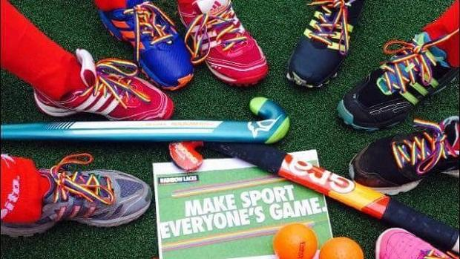
What are Rainbow Laces for?
LGBT people are often made to feel unwelcome in sport.
Rainbow Laces aims to make sure that LGBT people can feel safe and welcome when playing or watching sport.
People wear Rainbow Laces and armbands to show that they want to make sport everyone’s game.
Notes:
Use this slide to fill in any gaps of students’ prior knowledge in relation to the Rainbow Laces campaign.
As a class discuss: What might make LGBT people feel unwelcome in sport? Talk about lack of role models, discrimination, fear of discrimination, being left out.
Ask the class: Have you ever seen anyone wearing rainbow laces? Where did you see them?

Slide 8
Why is the campaign needed?
One in seven LGBT students have been bullied during PE.
64% of trans students say they are not able to play for the sports team they feel comfortable in.
One in five LGBT young people have experienced discrimination while exercising or at a sport group.
Notes:
If needed, explain that discrimination is when someone is treated unfairly because of something about them (for example because they are LGBT, because they are a person of colour, because they are a girl)
As a class discuss how it might feel to have the experiences described on the board.
What does it feel like to be bullied?
What would it be like for a boy not to be allowed to play for the boys’ team or for a girl not to be allowed to play for the girls’ team?
What would it feel like to be treated unfairly when you’re trying to have fun or exercise?

Slide 9
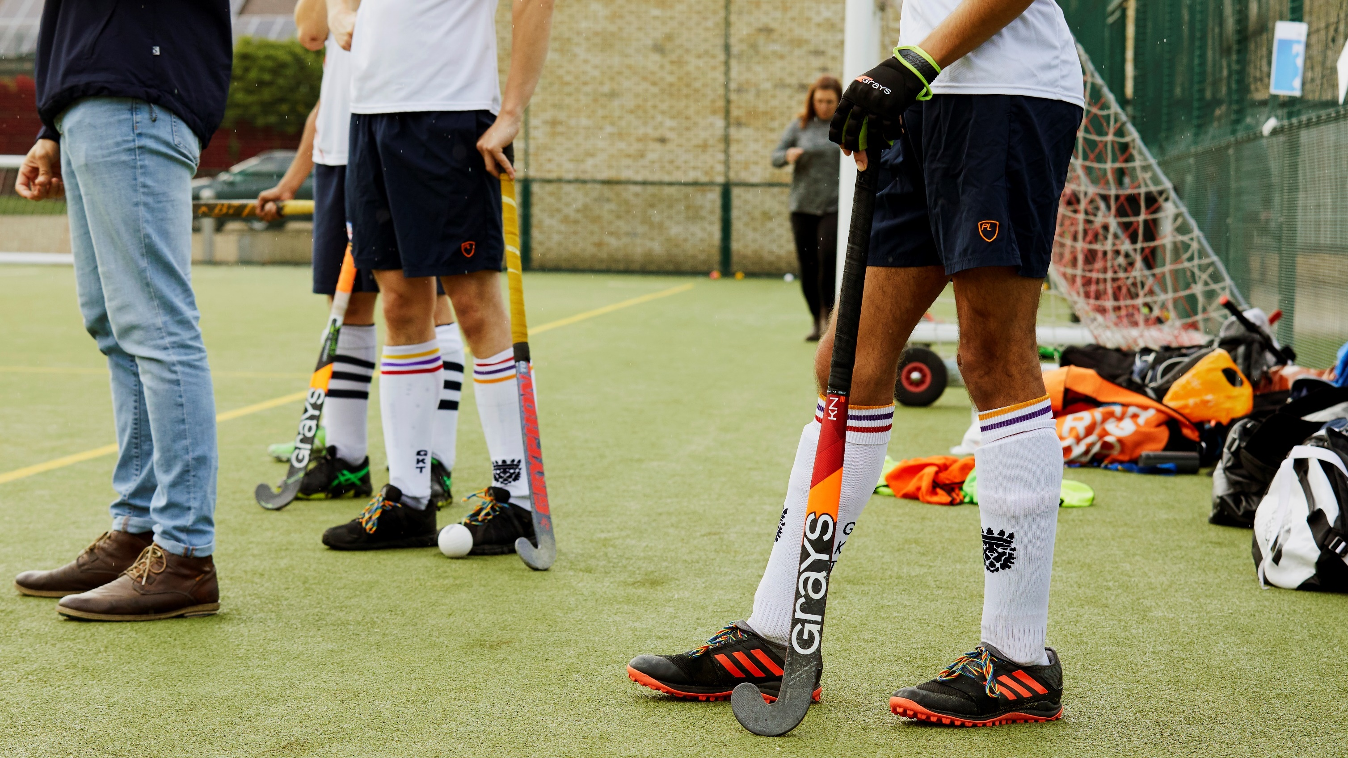
What is it like to feel unwelcome?
Notes:
Ask children to reflect on a time or a place where they felt unwelcome. What did it feel like?

Slide 10
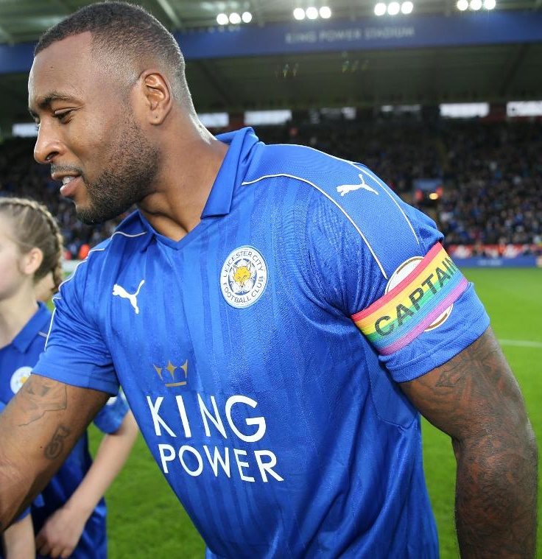
What can you do?
Speak out when you see people being treated unfairly or if they are being bullied
Celebrate people’s differences
Do your best to make sure other people feel welcome and included
Notes:
Remind students what they can do if they see someone experiencing discrimination or being bullied.
Link the celebration of difference to the school ethos

Slide 11
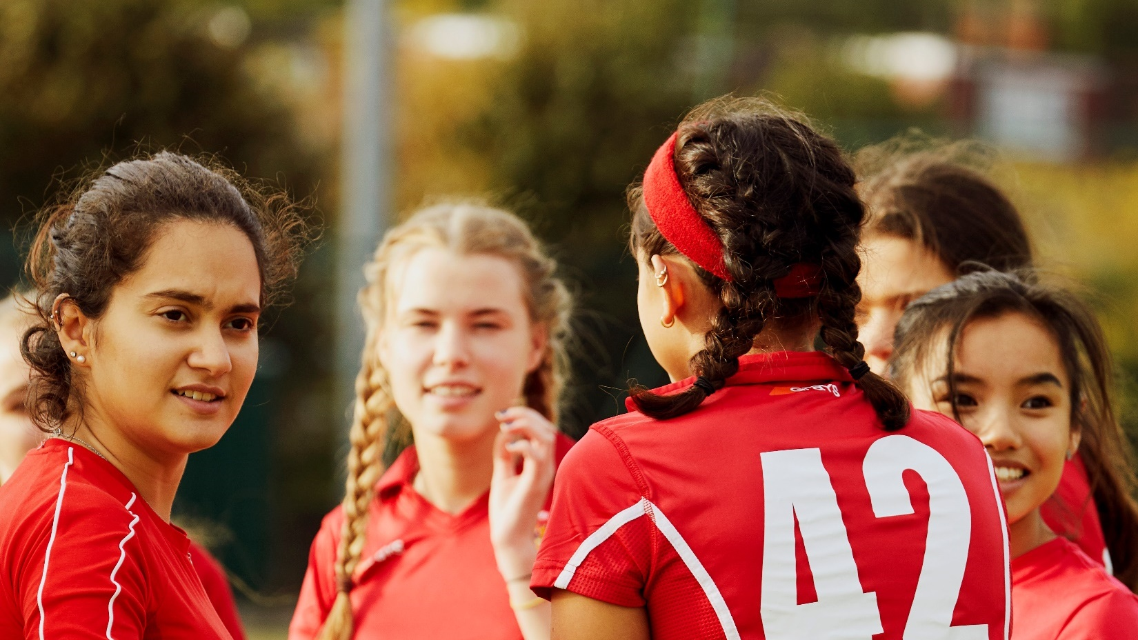
How will you make people feel welcome and included?
Notes:
Ask children to make a commitment to make others feel included. How will they show it?

