Slide 1
PowerPoint template to accompany the Relationships RSHE lesson pack for:
Year 5 and 6 – England and Wales
P6 and P7 - Scotland
We know that good teaching is tailored to meet the needs of the children or young people in each individual class. That’s why we’ve created this editable PowerPoint template – feel free to adapt it to suit your teaching context or to add your school or college slide template to the background.
Who are Stonewall?
This resource is produced by Stonewall, a UK-based charity that stands for the freedom, equity and potential of all lesbian, gay, bi, trans, queer, questioning and ace (LGBTQ+) people. At Stonewall, we imagine a world where LGBTQ+ people everywhere can live our lives to the full. Founded in London in 1989, we now work in each nation of the UK and have established partnerships across the globe. Over the last three decades, we have created transformative change in the lives of LGBTQ+ people in the UK, helping win equal rights around marriage, having children and inclusive education.
Our campaigns drive positive change for our communities, and our sustained change and empowerment programmes ensure that LGBTQ+ people can thrive throughout our lives. We make sure that the world hears and learns from our communities, and our work is grounded in evidence and expertise.
Stonewall is proud to provide information, support and guidance on LGBTQ+ inclusion; working towards a world where we’re all free to be. This does not constitute legal advice, and is not intended to be a substitute for legal counsel on any subject matter. To find out more about our work, visit us at www.stonewall.org.uk.
Registered Charity No 1101255 (England and Wales) and SC039681 (Scotland)
Notes:
Visit our website for the lesson plan to accompany this PowerPoint.

Slide 2
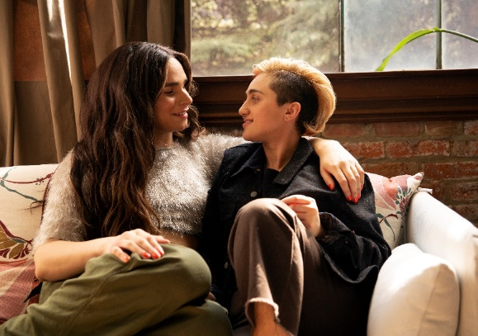
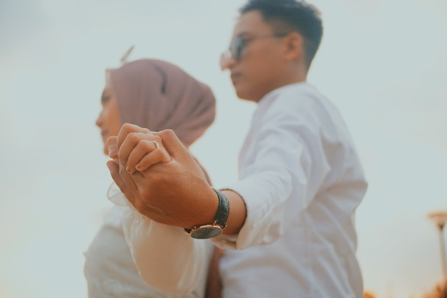
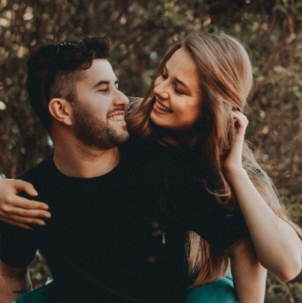
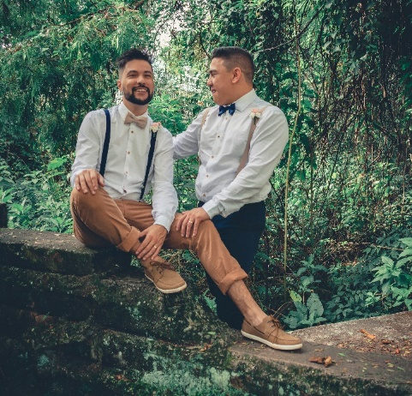
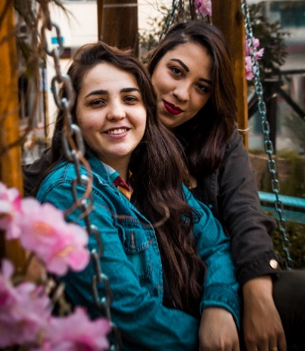
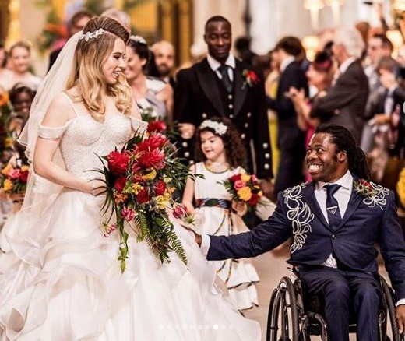
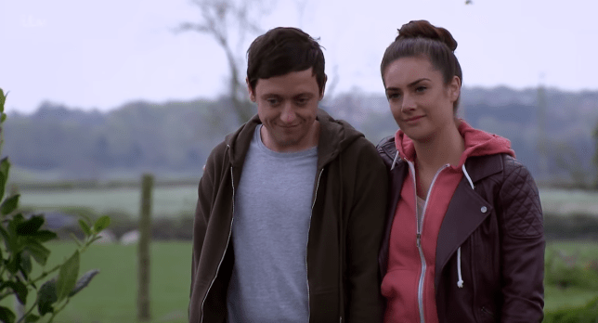
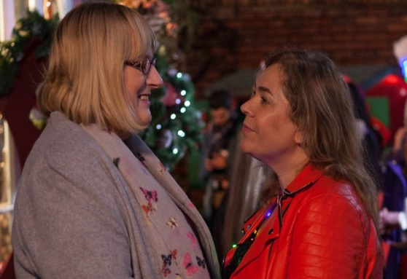
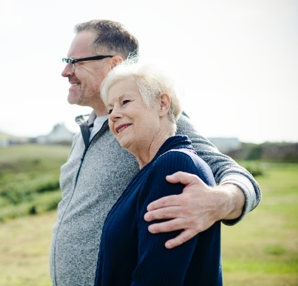
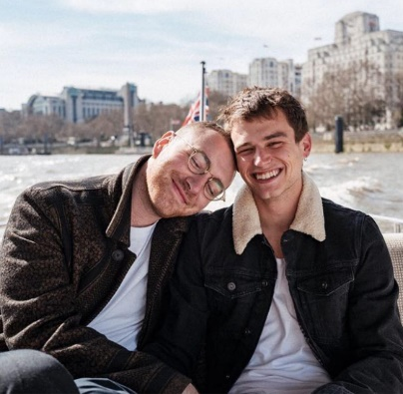
Notes:
What do all of these photos have in common? Discuss that the photos show people who are married or in a relationship with each other.
Discuss the different couples (same gender and different gender couples, couples where one person is trans and the other isn’t, couples where both people are trans, couples where neither are trans. Acknowledge that some people prefer not to be in a relationship and that that’s ok too. Discuss the difference between friendships, romantic relationships and the relationship between a child and their parent/carer.
Note: it is important to acknowledge we can’t always tell someone’s gender from looking at them. Both of the people in the top left photo are non-binary. Sam Smith, in the bottom right photo is non-binary.

Slide 3
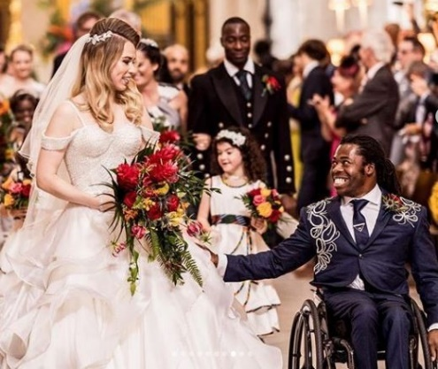
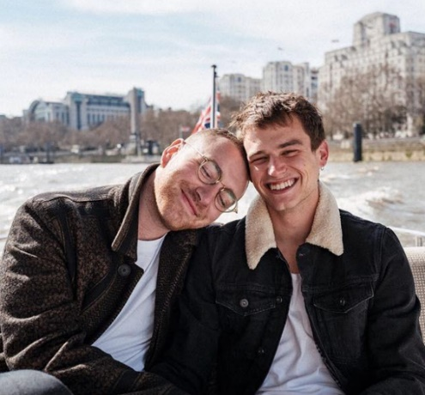
Different gender couples
Notes:
Different gender couples – the people in the relationships might be straight (heterosexual) or bi. Remember that different gender couples might include someone that is non-binary in a relationship with someone who isn’t.

Slide 4
Same gender couples
Notes:
Same gender couples – the people in the relationships might be lesbian, gay or bi. They may or may not be trans.

Slide 5
Trans people can be lesbian, gay or bi or straight. They might be in a relationship with someone who is the same gender or someone who is a different gender to them.
Notes:
Couples where one person is trans or both people are trans – trans people can be lesbian, gay or bi just like everyone else. In the photos, Matty is trans and dating a cisgender woman in Emmerdale. The couple in the top right photo are both non-binary. Sally in Hollyoaks is trans and married to a cisgender woman. Sam Smith Is non-binary and this photo is of them with their boyfriend.

Slide 6
LO: To understand the characteristics of a healthy relationship
What does a healthy relationship need?
Notes:
Ask: What does a healthy relationship need?
Think. Pair. Share. Scribe the ideas on the board.
Discuss the importance of love, respect, having things in
common, being caring and considerate and that a healthy
relationship is one where both people share those
feelings.

Slide 7
LO: To understand the characteristics of a healthy relationship
Recipe for a healthy relationship
Notes:
Children create a recipe for a healthy relationship.
For example:
1. Start with 2 people and mix with respect.
2. Add some shared interests.
3. Stir in some consideration.
4. Give it time to grow.
5. Sprinkle with love.
Children work in pairs or threes to make a poster about families. They should include some key words and phrases that show what family means to them (for example: love, togetherness, care, belonging). Their pictures should show different types of family.

Slide 8
LO: To understand the characteristics of a healthy relationship
Recipe for a healthy relationship
Underline an ingredient you liked in green
Add a new ingredient in pink
Notes:
Children swap their recipe with a partner. They should underline an ingredient they really liked in green and add a suggestion for another ingredient in pink. Share one or two excellent examples with the class. Children work in pairs or threes to make a poster about families. They should include some key words and phrases that show what family means to them (for example: love, togetherness, care, belonging). Their pictures should show different types of family.

