Slide 1
PowerPoint template for the 2019 Anti-Bullying Week Assembly for:
Key Stage 2 – England and Wales
P4 to P7 - Scotland
We know that good teaching is tailored to meet the needs of the children or young people in each individual class. That’s why we’ve created this editable PowerPoint template – feel free to adapt it to suit your teaching context or to add your school or college slide template to the background.
Who are Stonewall?
This resource is produced by Stonewall, a UK-based charity that stands for the freedom, equity and potential of all lesbian, gay, bi, trans, queer, questioning and ace (LGBTQ+) people. At Stonewall, we imagine a world where LGBTQ+ people everywhere can live our lives to the full. Founded in London in 1989, we now work in each nation of the UK and have established partnerships across the globe. Over the last three decades, we have created transformative change in the lives of LGBTQ+ people in the UK, helping win equal rights around marriage, having children and inclusive education.
Our campaigns drive positive change for our communities, and our sustained change and empowerment programmes ensure that LGBTQ+ people can thrive throughout our lives. We make sure that the world hears and learns from our communities, and our work is grounded in evidence and expertise.
Stonewall is proud to provide information, support and guidance on LGBTQ+ inclusion; working towards a world where we’re all free to be. This does not constitute legal advice, and is not intended to be a substitute for legal counsel on any subject matter. To find out more about our work, visit us at www.stonewall.org.uk.
Registered Charity No 1101255 (England and Wales) and SC039681 (Scotland)
Notes:
Other versions of this assembly are available on Stonewall’s website: www.stonewall.org.uk

Slide 2
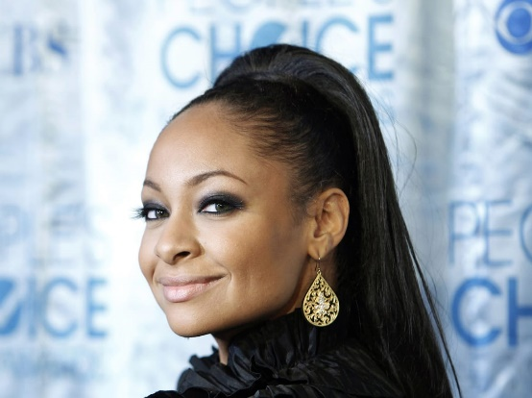
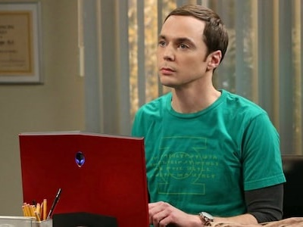
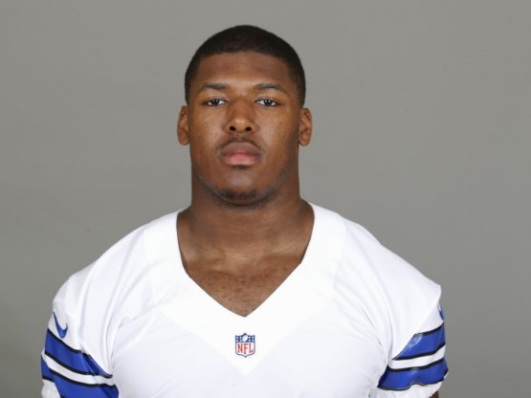
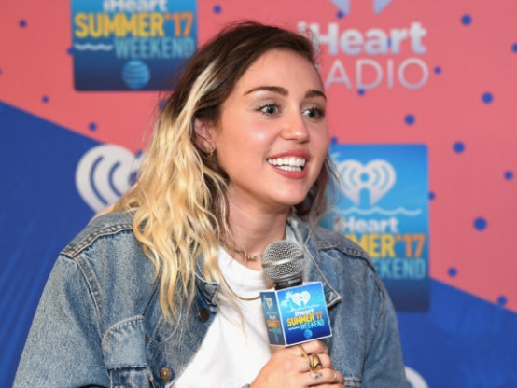
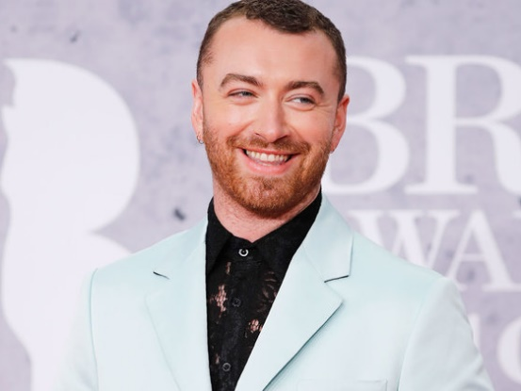
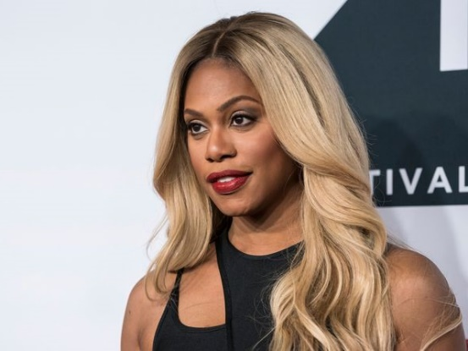
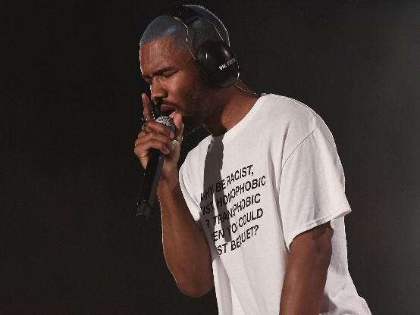
What do these celebrities have in common?
Notes:
Ask the children what these celebrities have in common – encourage hands up.
Answer: These celebrities are all members of the LGBT community.
1. Raven-Symoné, lesbian
2. Kate McKinnon, lesbian
3. Jim Parsons, gay
4. Ryan Russell, bi
6. Miley Cyrus, pansexual
7. Sam Smith, gay, non-binary
8. Laverne Cox, trans
9. Dr. Ranj, gay
10. Frank Ocean, bi

Slide 3
LGBT
What do the letters mean?
Notes:
Ask children for hands up if they know what the letters stand for.v

Slide 4
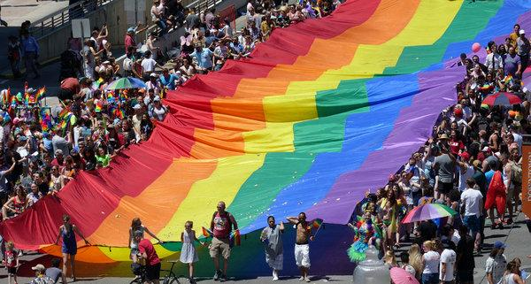
LGBT
What do the letters mean?
Lesbian
Gay
Bi
Trans
Notes:
Support with the following definitions for lesbian, gay, bi and trans.
Lesbian: a woman who falls in love with other women
Gay: a man who falls in love with other men
Bi: someone who falls in love with people and it doesn’t matter if they are a man, woman or non-binary
Trans: Someone who was given the wrong label at birth – as a boy but they actually feel like a girl, as a girl but they actually feel like a boy or as a boy or girl but actually they’re non-binary.

Slide 5
Notes:
Explain that it is anti-bullying week and the theme is “Change Starts With Us”. Explain why LGBT inclusion is so important.
This year the goal is to inform schools and settings, children and young people, parents and carers to know that it takes a collective responsibility to stop bullying.
Bullying is usually defined as repeated behavior which is intended to hurt someone either emotionally or physically.

Slide 6
Notes:
Encourage the children to look at the poster and spot the mistakes.
Explain that this a misuse of the word and makes no real sense! Explain that the word “gay” is not taboo but the use of it in this context is hurtful. If you mean rubbish, say “rubbish”.

Slide 7
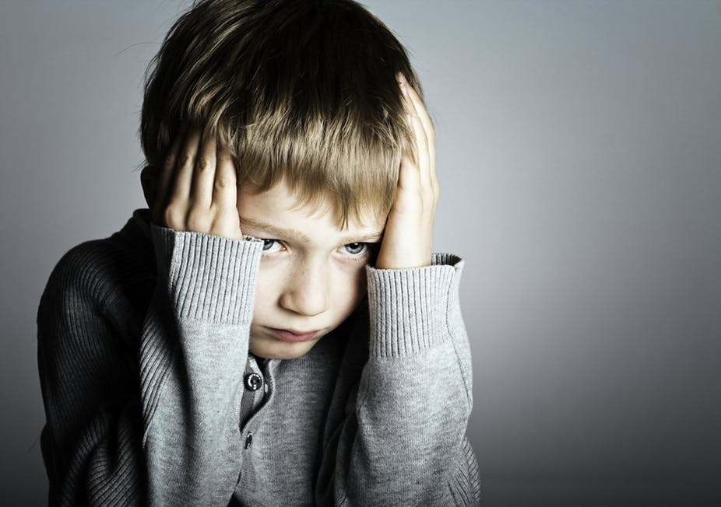
The Stonewall School Report (2017) found that…
Nearly half of LGBT young people are bullied for being LGBT
Half of LGBT pupils hear homophobic slurs ‘frequently’ or ‘often’ at school
Notes:
Ask the children: “What might homophobic, biphobic and transphobic bullying look like?”
How might it feel to be bullied for who you are or who you fall in love with? Or because you’ve got 2 mums, 2 dads or a trans parent?

Slide 8
PAUSE
Notes:
Pause for thought. Encourage the children to take a moment to reflect on how they can tackle homophobic, biphobic and transphobic bullying.

Slide 9
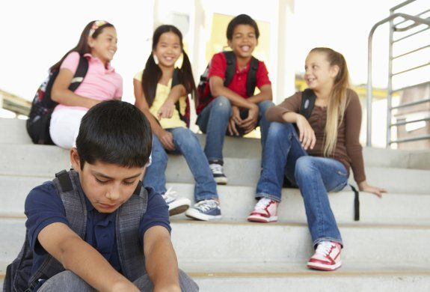
Challenge HBT bullying!
What can we do to help stop bullying?
THINK before you speak
REPORT bullying to an adult
HELP others to report bullying
CELEBRATE that we are all different
Notes:
Talk the children through this slide on how they can tackle bullying – link this to your behavior policy and school values.
Respect/Kind Words Remember to be kind to other people! Stop and think before you say or do something that could hurt someone. Just because someone is different to you – that doesn’t mean you are better than them or have a right to make them feel bad. Keep in mind that everyone is different. Not better or worse. Just different. If you mess up, say sorry. You don’t have to be friends with everyone – but you should always show respect. Support Make it clear that you don’t like it when people bully others and stick up for people who are having a hard time. Show them that you care by trying to include them. Sit with them at lunch or on the bus, talk to them at school, or invite them to do something. Just hanging out with them will help them know they aren’t alone. Report The important thing is that you tell someone. Don’t keep your feelings inside. Not saying anything could make it worse for everyone. The child who is bullying will think it is ok to keep treating others that way. Telling someone can help you feel less alone. They can help stop the bullying. If you feel you can, talk to a teacher you trust or your parents, brother or sister. If you don’t want to do that you can always call Childline 0800 11 11 or visit www.childline.org.uk.

Slide 10
Love your differences
Love other people’s differences
Notes:
Ask children to reflect on what they will do to make sure everyone feels included and celebrated.

