Slide 1
PowerPoint template for the 2019 Anti-Bullying Week Assembly for:
Learners with SEND/ALN/ASN – version 2
We know that good teaching is tailored to meet the needs of the children or young people in each individual class. That’s why we’ve created this editable PowerPoint template – feel free to adapt it to suit your teaching context or to add your school or college slide template to the background.
Who are Stonewall?
This resource is produced by Stonewall, a UK-based charity that stands for the freedom, equity and potential of all lesbian, gay, bi, trans, queer, questioning and ace (LGBTQ+) people. At Stonewall, we imagine a world where LGBTQ+ people everywhere can live our lives to the full. Founded in London in 1989, we now work in each nation of the UK and have established partnerships across the globe. Over the last three decades, we have created transformative change in the lives of LGBTQ+ people in the UK, helping win equal rights around marriage, having children and inclusive education.
Our campaigns drive positive change for our communities, and our sustained change and empowerment programmes ensure that LGBTQ+ people can thrive throughout our lives. We make sure that the world hears and learns from our communities, and our work is grounded in evidence and expertise.
Stonewall is proud to provide information, support and guidance on LGBTQ+ inclusion; working towards a world where we’re all free to be. This does not constitute legal advice, and is not intended to be a substitute for legal counsel on any subject matter. To find out more about our work, visit us at www.stonewall.org.uk.
Registered Charity No 1101255 (England and Wales) and SC039681 (Scotland)
Notes:
Other versions of this assembly are available on Stonewall’s website: www.stonewall.org.uk

Slide 2
You need to calm down…
Notes:
Introduce the assembly, explain to students that you are Stonewall School Champion school.
Watch the ‘You Need to Calm Down’ video by Taylor Swift: https://www.youtube.com/watch?v=Dkk9gvTmCXY
Encourage students to listen to the lyrics.

Slide 3
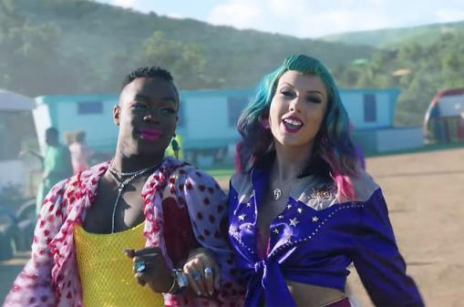
What was the message of the song?
The song is asking people to be kind to lesbian, gay, bi and trans people.
It is asking people to calm down and stop being hateful.
Notes:
Talk about the lyrics of the song: “You are somebody that I don’t know but you’re coming at my friends like a missile”, “sunshine on the street at the parade, but you would rather be in the dark ages”, “control the urges to scream about all the people you hate”.
Explain that Taylor is asking people to be kind to her lesbian, gay, bi and trans friends. She wants people to stop being hateful.

Slide 4
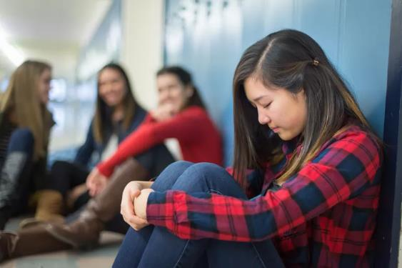
What is bullying?
Notes:
If they are able, ask students to define bullying.

Slide 5
What is bullying?
If someone calls you names.
If someone hurts you on purpose.
If someone leaves you out on purpose.
If someone sends you unkind messages, photos or videos.
If they do it lots of times.
Notes:
Discuss what bullying is – talk about emotional, verbal, physical, written and cyberbullying. Talk about it being several times on purpose.

Slide 6
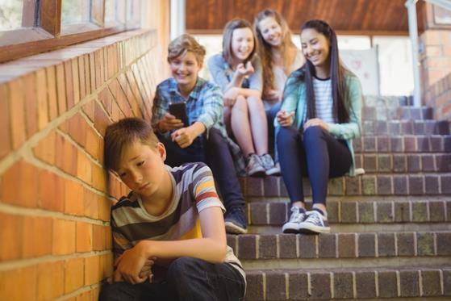
Homophobic bullying
Notes:
What is homophobic bullying?

Slide 7
Homophobic bullying
Bullying someone because they are lesbian or gay.
Notes:
Explain what homophobic bullying is. Remind students what lesbian and gay mean, if required.

Slide 8
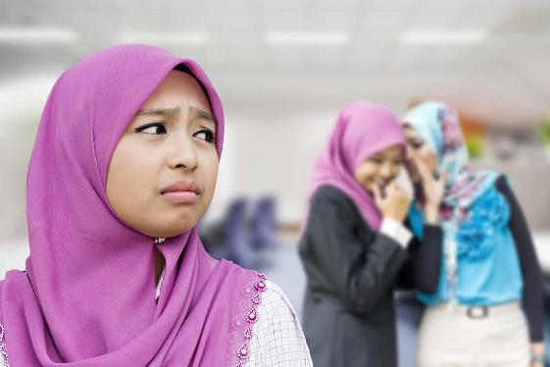
Biphobic bullying
Notes:
What is biphobic bullying?

Slide 9
Biphobic bullying
Bullying someone because they are bi.
Notes:
Remind students what bi means, if required.

Slide 10
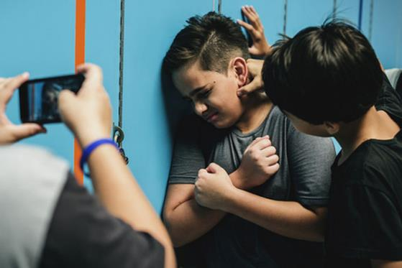
Transphobic bullying
Notes:
What is transphobic bullying?

Slide 11
Transphobic bullying
Bullying someone because they are trans.
Notes:
Remind students what trans means, if required.

Slide 12
Notes:
Explain that it is anti-bullying week and the theme is “Change Starts With Us”.
We all need to think about how we can challenge bullying.

Slide 13
What will you do to help stop bullying at our school?
Notes:
Ask students what we could do as school to challenge bullying?

Slide 14
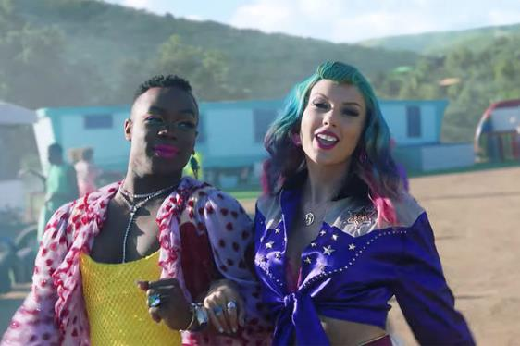
What will you do to help stop bullying at our school?
Be kind to other people.
Be gentle to other people.
Tell an adult if someone is being unkind.
Notes:
Discuss with students that they should be kind to others, be gentle to others (hands and feet to yourself), tell an adult if someone is being unkind.

