Slide 1
PowerPoint template for the 2021 Black History Month Assembly for:
Key Stage 2– England and Wales
P4 to P7 – Scotland
We know that good teaching is tailored to meet the needs of the children or young people in each individual class. That’s why we’ve created this editable PowerPoint template – feel free to adapt it to suit your teaching context or to add your school or college slide template to the background.
Who are Stonewall?
This resource is produced by Stonewall, a UK-based charity that stands for the freedom, equity and potential of all lesbian, gay, bi, trans, queer, questioning and ace (LGBTQ+) people. At Stonewall, we imagine a world where LGBTQ+ people everywhere can live our lives to the full. Founded in London in 1989, we now work in each nation of the UK and have established partnerships across the globe. Over the last three decades, we have created transformative change in the lives of LGBTQ+ people in the UK, helping win equal rights around marriage, having children and inclusive education.
Our campaigns drive positive change for our communities, and our sustained change and empowerment programmes ensure that LGBTQ+ people can thrive throughout our lives. We make sure that the world hears and learns from our communities, and our work is grounded in evidence and expertise.
Stonewall is proud to provide information, support and guidance on LGBTQ+ inclusion; working towards a world where we’re all free to be. This does not constitute legal advice, and is not intended to be a substitute for legal counsel on any subject matter. To find out more about our work, visit us at www.stonewall.org.uk.
Registered Charity No 1101255 (England and Wales) and SC039681 (Scotland)
Notes:
Visit our website for the lesson plan to accompany this PowerPoint.

Slide 2
Opening title slide
Black History Month
Notes:
This assembly is for children in Key Stage 2/P4-P7. Check our website www.stonewall.org.uk for a similar assembly for younger children or for secondary aged students. You’ll also find versions of this assembly for children and young people with SEND/ALN/ASN.

Slide 3
Divider slide 2
What is Black History Month?
?
?
?
?
Notes:
Ask the children if they have heard of Black History Month before. Why might it be needed?
Explain that too often the history of Black people in Britain and across the world is overlooked. That includes it being overlooked in schools. This is because some people don’t think Black people’s lives and stories are important. We know that’s wrong and that everyone’s story is important. That’s why we’re celebrating Black History Month. This is a great time to be celebrating some amazing Black people from our history. And that’s just what we’re going to be doing in this assembly.

Slide 4
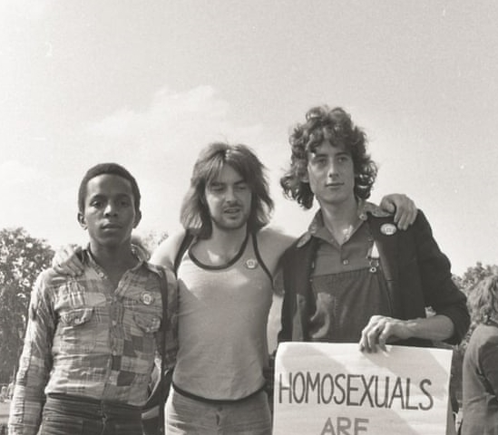
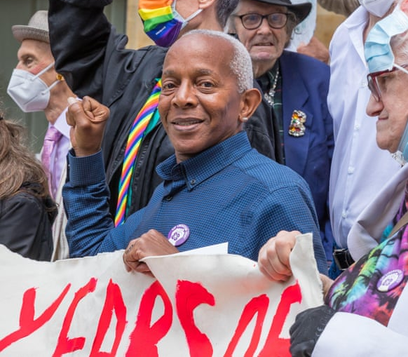
Quote and image slide 1
Ted Brown
What clues in the photo tell us who Ted is and why we might be learning about him?
Notes:
Introduce Ted Brown – from the photos, can the children spot any clues that show us what he’s famous for?

Slide 5
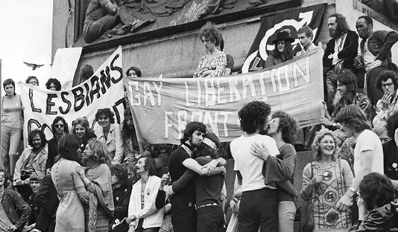
Quote and image slide 1
Ted Brown
Some more clues from an event Ted helped to organise.
Notes:
Show the children some more clues from a big event that Ted helped to organise. Are there any clues about the type of event it was?

Slide 6
Quote and image slide 1
Ted Brown
One of the early members of the Gay Liberation Front.
In 1972 was involved in organizing the first LGBTQ+ pride march in London.
There was a march through London and then a ‘kiss in’ at Trafalgar Square.
Notes:
Introduce Ted Brown – he was one of the early members of an organisation called the Gay Liberation Front, which is an organisation that campaigned for fair and equal treatment for LGBTQ+ people in the UK. The UK’s first Pride March was in 1972 and involved a kiss in at Trafalgar Square – Ted helped to organise this and many other marches and protests. Ted was one of only a few Black people at the march – not because there weren’t many Black LGBTQ+ people, but because Black LGBTQ+ people experienced (and still experience) racism as well as homophobia, biphobia and transphobia, making it even scarier to attend a public protest.

Slide 7
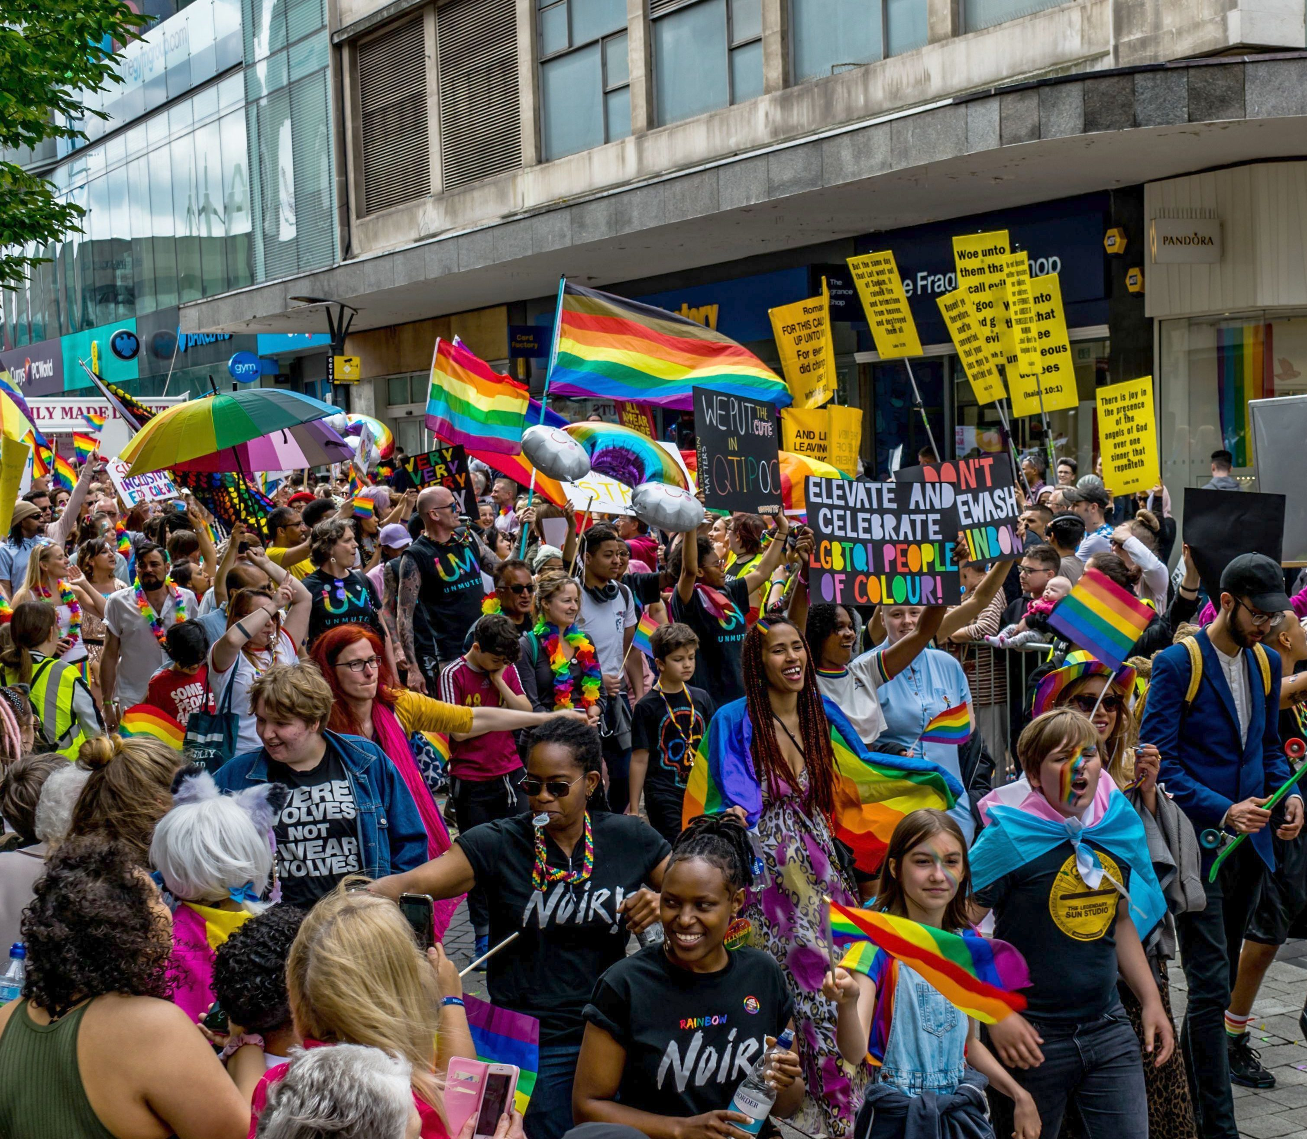
Infographic slide - style 1
Have you heard of LGBTQ+ pride?
London, 1972
Birmingham, 2019
Notes:
Ask children if they have heard of LGBTQ+ pride? What is it?
Explain that in 1972:
Being LGBTQ+ was classed as an illness – people now realise that some people just are LGBTQ+ and it’s ok
There were no laws against homophobic, biphobic and transphobic discrimination
Homophobia, biphobia and transphobia was common (and sadly still is)
LGBTQ+ people couldn’t get married and having children was frowned upon
Gay men frequently experienced police harassment – this is something that also happened to Black people too. (For teacher background knowledge see: https://www.crimeandjustice.org.uk/sites/crimeandjustice.org.uk/files/09627250608553116.pdf and https://galop.org.uk/about/history/)
Ask students why LGBTQ+ pride might still be needed.
Ensure that you have discussed:
LGBTQ+ people are often still treated unfairly at work, in education and in the community
There are still countries where it is illegal to be LGBTQ+ and where LGBTQ+ people can’t get married or have children.

Slide 8
Quote and image slide 2
Who are the Gay Liberation Front?
The UK’s Gay Liberation Front held their first meeting in 1970, inspired by the 1969 Stonewall riots.
Their first protest was in 1970 and was run by people who met at the Mangrove, a Caribbean restaurant in London.
The Gay Liberation Front were inspired by and had links to The Black Panthers.
Notes:
Quickly explain who the Gay Liberation Front were.
The UK’s Gay Liberation Front held their first meeting in 1970, inspired by the 1969 Stonewall riots.
Their first protest was in 1970 and was run by people who met at the Mangrove, a Caribbean restaurant in London.
The Gay Liberation Front were inspired by and had links to The Black Panthers – the Black Panthers also had meetings at the Mangrove.

Slide 9
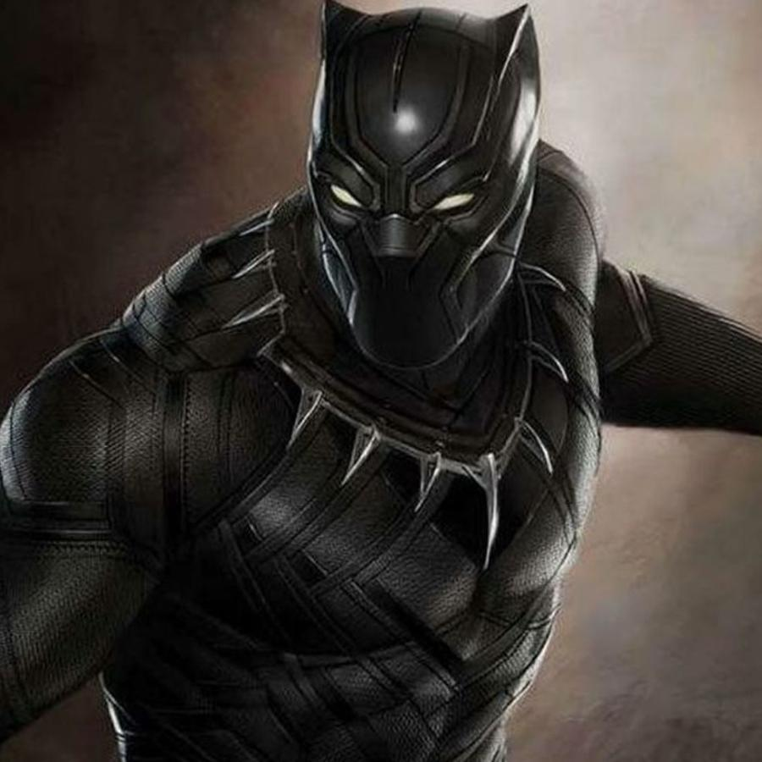
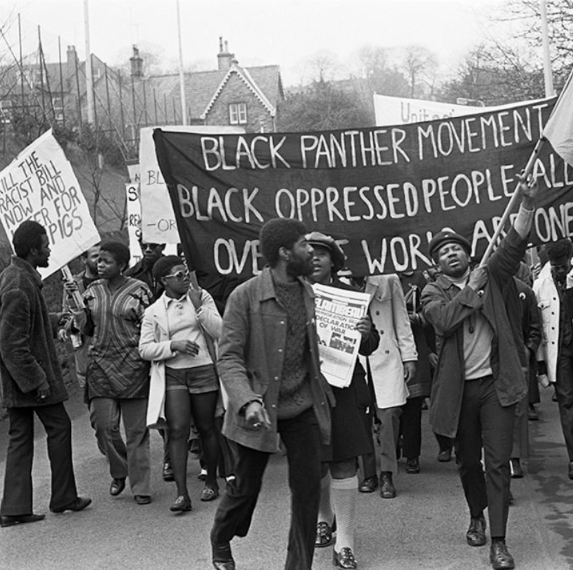
Infographic slide - style 1
Who came first?
Black Panther
The Black Panthers
Notes:
The Black Panthers came first! It is thought that the person who invented the Marvel Black Panther character was inspired The Black Panthers’ logo.

Slide 10
Quote and image slide 2
Who were the Black Panthers?
A Black led and run political organization.
They protested against racism and police harassment.
The gave free breakfast to children, ran education centres, and health clinics.
Notes:
Explain who the Black Panthers were.
A Black led and run political organization set up in 1966 in the United States, with chapters worldwide.
Campaigned and protested against racism and police harassment. For example, in London there were protests against police harassment organized by the British Black Panthers.
They set up community initiatives such as providing free breakfast for children, education programmes, and health clinics.

Slide 11
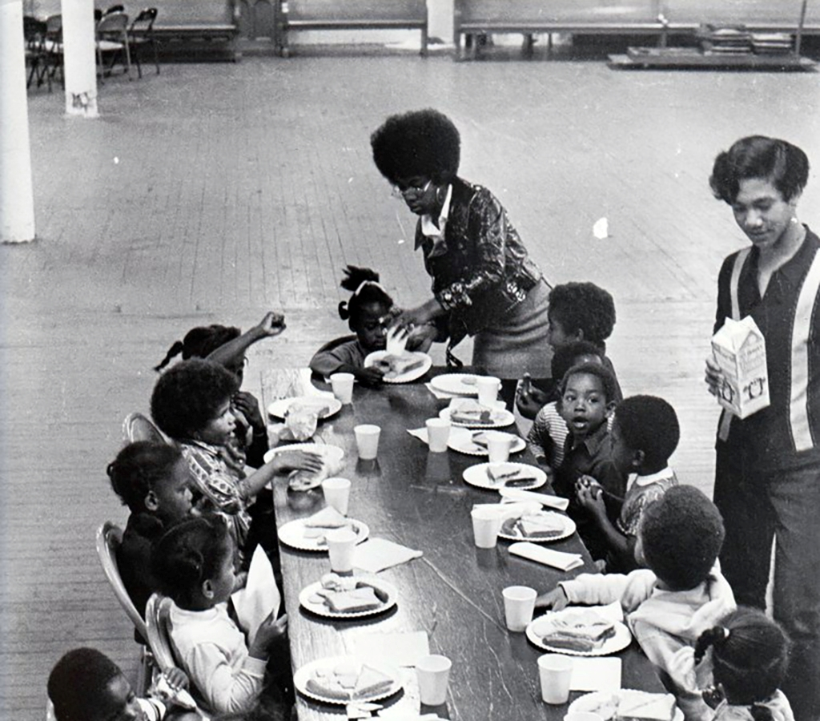
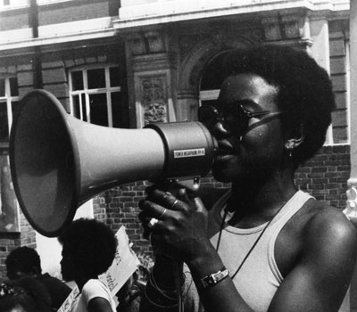
Infographic slide - style 1
Why were the Black Panthers needed?
What is racism?
Notes:
Ask children to think why the Black Panthers might have been needed. What is racism?
Explain that racism is when people are treated unfairly because of the colour of their skin.
Ensure that you have discussed:
In the past, racism was widespread and this included racism from public bodies such as the Police and government.
Racism impacted the quality of education that People of Colour received and how they were treated at schools – hence the need for education programmes
Children did not learn about Black history at school
Racism impacted the jobs people were able to get and how much money they earned – hence the need for things like free breakfast for children
The healthcare systems, especially in the United States, did not meet specific needs of Black people – and in the United States people often couldn’t afford to pay for treatment.
Ask students if anti racist work is still needed.
Ensure that they understand that it is!
People of Colour still face racism in their day to day lives – from people on the street, in work and education.
People of Colour still face healthcare inequalities, education inequalities and housing inequalities.
(For teacher background knowledge, see: https://library.oapen.org/handle/20.500.12657/22310)

Slide 12
Quote and image slide 1
Be more Ted
Ted Brown remains committed to making the world a fairer place.
What will you do to make the world a fairer place?
Notes:
Ted Brown remains committed to addressing all forms of injustice and discrimination, but particularly racism, homophobia, biphobia and transphobia. He wants to make the world a fairer place.
Ask students to reflect on what they will do in their daily life to make the world a fairer place.

