Slide 1
PowerPoint template for the 2021 Black History Month Assembly for:
Reception and Key Stage 1– England and Wales
P1 to P3 – Scotland
We know that good teaching is tailored to meet the needs of the children or young people in each individual class. That’s why we’ve created this editable PowerPoint template – feel free to adapt it to suit your teaching context or to add your school or college slide template to the background.
Who are Stonewall?
This resource is produced by Stonewall, a UK-based charity that stands for the freedom, equity and potential of all lesbian, gay, bi, trans, queer, questioning and ace (LGBTQ+) people. At Stonewall, we imagine a world where LGBTQ+ people everywhere can live our lives to the full. Founded in London in 1989, we now work in each nation of the UK and have established partnerships across the globe. Over the last three decades, we have created transformative change in the lives of LGBTQ+ people in the UK, helping win equal rights around marriage, having children and inclusive education.
Our campaigns drive positive change for our communities, and our sustained change and empowerment programmes ensure that LGBTQ+ people can thrive throughout our lives. We make sure that the world hears and learns from our communities, and our work is grounded in evidence and expertise.
Stonewall is proud to provide information, support and guidance on LGBTQ+ inclusion; working towards a world where we’re all free to be. This does not constitute legal advice, and is not intended to be a substitute for legal counsel on any subject matter. To find out more about our work, visit us at www.stonewall.org.uk.
Registered Charity No 1101255 (England and Wales) and SC039681 (Scotland)
Notes:
Visit our website for the lesson plan to accompany this PowerPoint.

Slide 2
Opening title slide
Black History Month
Notes:
This assembly is for children in Reception and Key Stage 1/P1-P3. Check our website www.stonewall.org.uk for a similar assembly for Key Stage 2/P4-P7 children or for secondary aged students. You’ll also find versions of this assembly for children and young people with SEND/ALN/ASN.

Slide 3
Divider slide 2
What is Black History Month?
?
?
?
?
Notes:
Ask the children if they have heard of Black History Month before. Why might it be needed?
Explain that people often don’t know much about the history of Black people in Britain and across the world. That’s because some people think that white people’s lives are more important. We know that’s not true and that it’s important to hear lots of different people’s stories. That’s why we’re celebrating Black History Month – to give us a chance to focus on learning about Black people’s stories and lives. And that’s just what we’re going to be doing in this assembly.

Slide 4
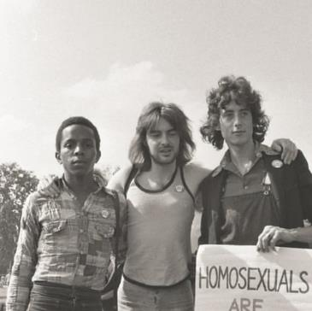
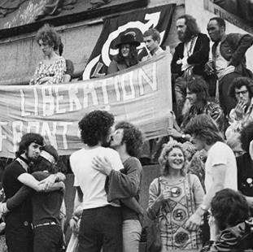
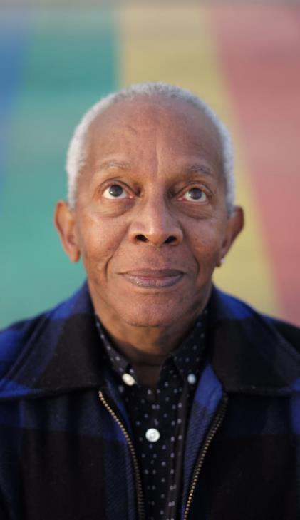
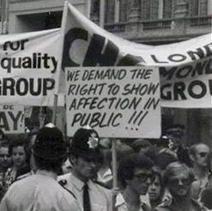
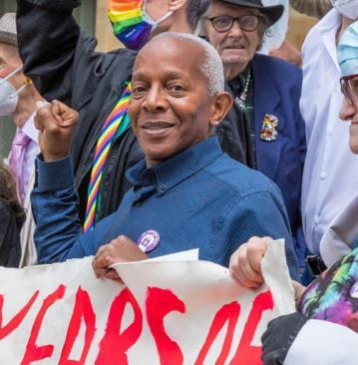
Infographic slide – style 2
Ted Brown
What clues do the pictures give you about him?
?
?
?
?
Notes:
Introduce Ted Brown – from the photos, can the children spot any clues that show who he is or what he was involved in?

Slide 5
Quote and image slide 1
Ted Brown
He helped organise protest marches in London.
He and his friends were asking for LGBTQ+ people to be treated fairly.
They were inspired by an organization called The Black Panthers.
Notes:
Introduce Ted Brown – in the 1970s he organised lots of protest marches in London. In the 1970s, LGBTQ+ people were treated very unfairly. Ted and his friends were asking for LGBTQ+ people to be treated fairly. That means treating someone fairly whether they fall in love with a man, a woman or a non-binary person and treating them fairly whether they are trans or not. Ted and his friends were in a group called The Gay Liberation Front. This group was inspired by an organization called The Black Panthers.
(For teacher background knowledge see https://galop.org.uk/about/history/)

Slide 6
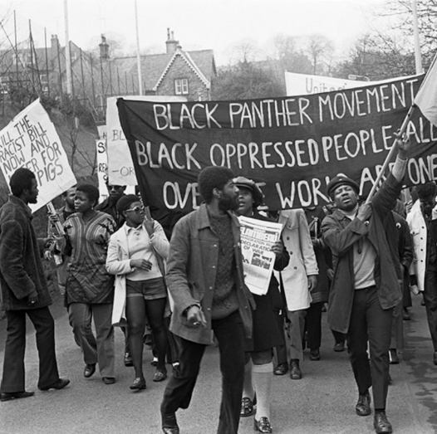
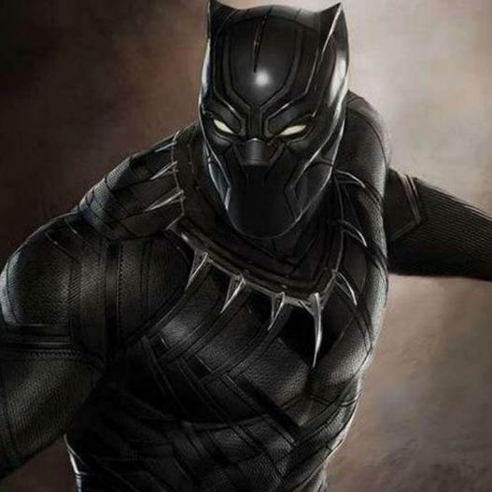
Infographic slide - style 1
The Black Panthers, not The Black Panther.
The Black Panthers
Black Panther
Notes:
The Black Panthers came first! It is thought that the person who invented the Marvel Black Panther character was inspired The Black Panthers’ logo.

Slide 7
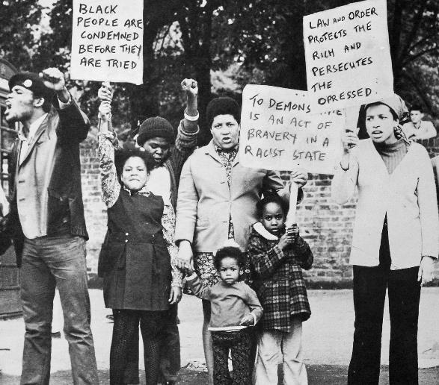
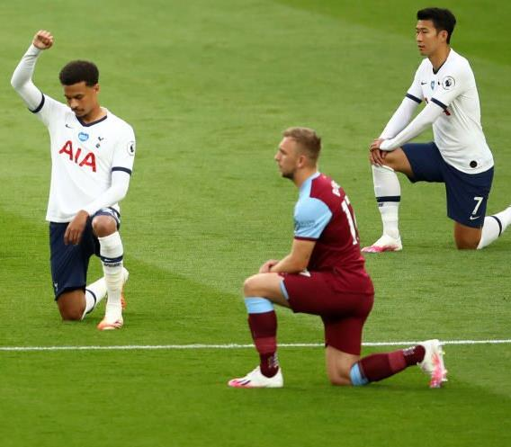
Infographic slide - style 1
What is racism?
The Black Panthers wanted everyone to be treated fairly.
Notes:
Ask children: What is racism? Have you heard this word before?
Explain that The Black Panthers wanted everyone to be treated fairly.
Explain that racism is when people are treated unfairly because of the colour of their skin.
In the past racism was widespread and it impacted every part of someone’s life.
Sadly racism does still exist and we all have a part to play in saying no to racism. Explain that when footballers taking the knee before football matches, that is a protest against racism.
(For teacher background knowledge, see: https://library.oapen.org/handle/20.500.12657/22310)

Slide 8
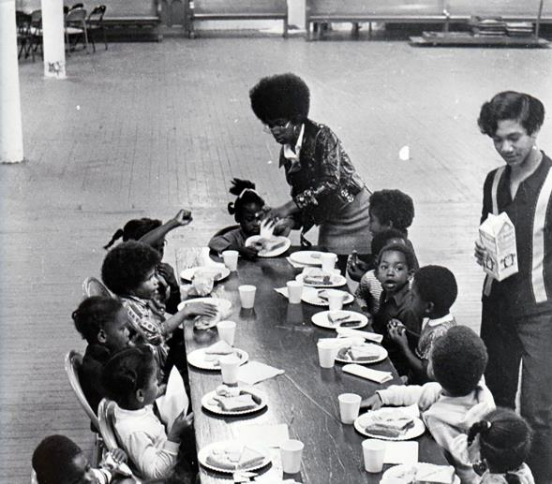
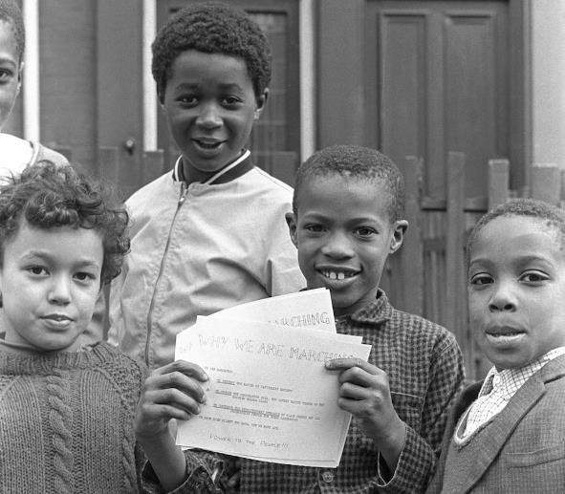
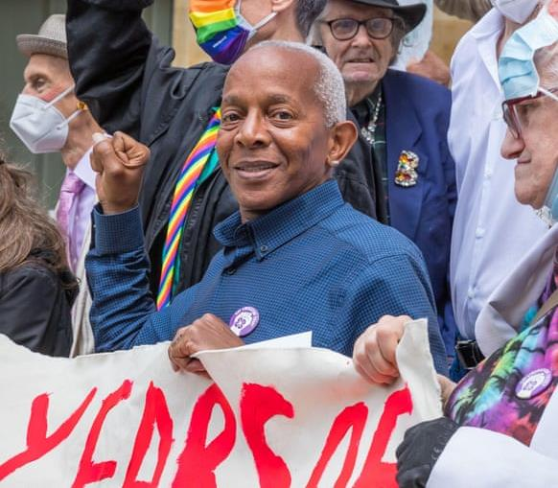
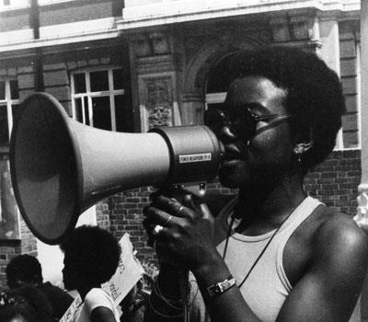
Infographic slide - style 1
What did the Black Panthers do?
Free breakfast
Learning
Protesting
Notes:
Explain that The Black Panthers worked to make the world a fairer place. They wanted children to go to school with food in their tummies, so they gave free breakfasts. They wanted people to learn about Black History, so they taught people about it. They wanted Black people and People of Colour to be treated fairly, so they organised protests and spoke out against racism.

Slide 9
Quote and image slide 1
Be like Ted
Ted Brown wants the world to be a fairer place.
What will you do to make the world a fairer place?
Notes:
Ted Brown remains committed to addressing all forms of injustice and discrimination, but particularly racism, homophobia, biphobia and transphobia. He wants to make the world a fairer place.
Ask the children to reflect on what they will do in their daily life to make the world a fairer place.

